Slide 1

Chapter 26
IPv6
Addressing
Copyright © The McGraw-Hill Companies, Inc. Permission required for reproduction or display.

Slide 2
OBJECTIVES:
To introduce the IPv6 addressing scheme and different notations used to represent an address in this version.
To explain the three types of addressing used in IPv6: unicast, anycast, and multicast.
To show the address space in this version and how it is divided into several blocks.
To discuss some reserved blocks in the address space and their applications.
To define the global unicast address block and how it is used for unicast communication.
To discuss how three levels of hierarchy in addressing are used in IPv6 deploying the global unicast block.
To discuss autoconfiguration and renumbering of IPv6 addresses.

Slide 3
Chapter
Outline
26.1 Introduction
26.2 Address Space Allocation
26.3 Global Unicast Addresses
26.4 Autoconfiguration
26.5 Renumbering

Slide 4
26-1 INTRODUCTION
An IPv6 address is 128 bits or 16 bytes (octet) long as shown in Figure 26.1. The address length in IPv6 is four times of the length address in IPv4.

Slide 5
Topics Discussed in the Section
Notations
Address Space
Three Address Types
Broadcasting and Multicasting

Slide 6
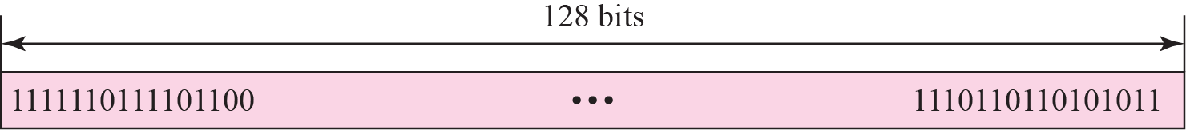
Figure 26.1 IPv6 addresses

Slide 7
Figure 26.2 Colon hexadecimal notation

Slide 8
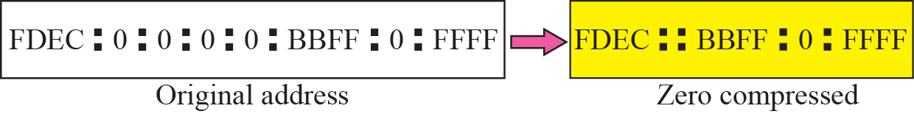
Figure 26.3 Zero compression

Slide 9
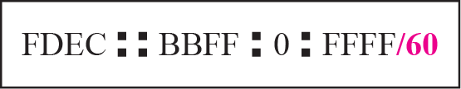
Figure 26.4 CIDR address

Slide 10
Example 26.1
Show the unabbreviated colon hex notation for the following IPv6 addresses:
a. An address with 64 0s followed by 64 1s.
b. An address with 128 0s.
c. An address with 128 1s.
d. An address with 128 alternative 1s and 0s.
Solution
a. 0000:0000:0000:0000:FFFF:FFFF:FFFF:FFFF
b. 0000:0000:0000:0000:0000:0000:0000:0000
c. FFFF:FFFF:FFFF:FFFF:FFFF:FFFF:FFFF:FFFF
d. AAAA:AAAA:AAAA:AAAA:AAAA:AAAA:AAAA:AAAA

Slide 11
Example 26.2
The following shows the zero contraction version of addresses in Example 26.1 (part c and d cannot be abbreviated)
a. :: FFFF:FFFF:FFFF:FFFF
b. ::
c. FFFF:FFFF:FFFF:FFFF:FFFF:FFFF:FFFF:FFFF
d. AAAA:AAAA:AAAA:AAAA:AAAA:AAAA:AAAA:AAAA

Slide 12
Example 26.3
Show abbreviations for the following addresses:
a. 0000:0000:FFFF:0000:0000:0000:0000:0000
b. 1234:2346:0000:0000:0000:0000:0000:1111
c. 0000:0001:0000:0000:0000:0000:1200:1000
d. 0000:0000:0000:0000:0000:FFFF:24.123.12.6
Solution
a. 0:0:FFFF::
b. 1234:2346::1111
c. 0:1::1200:1000
d. ::FFFF:24.123.12.6

Slide 13
Example 26.4
Decompress the following addresses and show the complete unabbreviated IPv6 address:
a. 1111::2222
b. ::
c. 0:1::
d. AAAA:A:AA::1234
Solution
a. 1111:0000:0000:0000:0000:0000:0000:2222
b. 0000:0000:0000:0000:0000:0000:0000:0000
c. 0000:0001:0000:0000:0000:0000:0000:0000
d. AAAA:000A:00AA:0000:0000:0000:0000:1234

Slide 14
Example 26.5
To give some idea about the number of addresses, let us assume that the number of people on the planet earth is soon to be 2³⁴ (more than 16 billion). Each person can have 2⁹⁴ addresses to use.

Slide 15
Example 26.6
If we assign 2⁶⁰ addresses to the users each year (almost one billion each second), it takes 2⁶⁸ years to deplete addresses.

Slide 16
Example 26.7
If we can build a high-rise building over the land and sea to accommodate 2⁶⁸ computers in each square meter of the earth, still there are enough addresses to connect all computers to the Internet (the planet earth is approximately 2⁶⁰ square meters).

Slide 17
26-2 ADDRESS SPACE ALLOCATION
Like the address space of IPv4, the address space of IPv6 is divided into several blocks of varying size and each block is allocated for special purpose. Most of the blocks are still unassigned and have been left aside for future use. To better understand the allocation and the location of each block in address space, we first divide the whole address space into eight equal ranges. This division does not show the block allocation, but we believe it shows where each actual block is located (Figure 26.5).

Slide 18
Topics Discussed in the Section
Assigned and Reserved Blocks

Slide 19
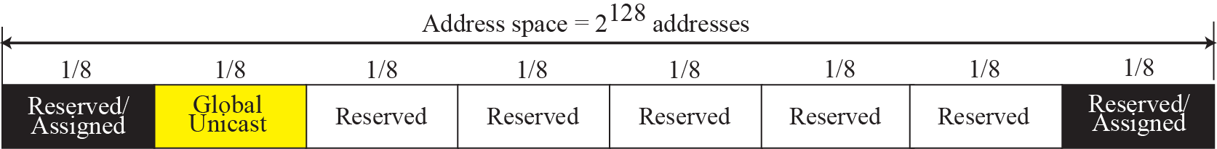
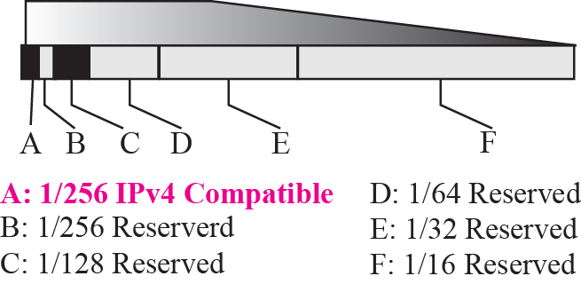
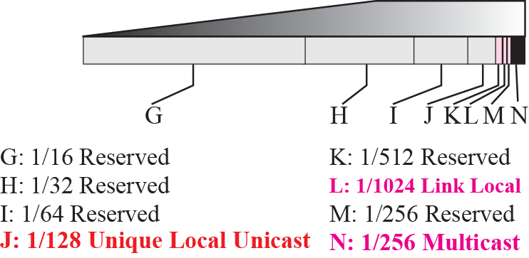
Figure 26.5 Address space allocation

Slide 20
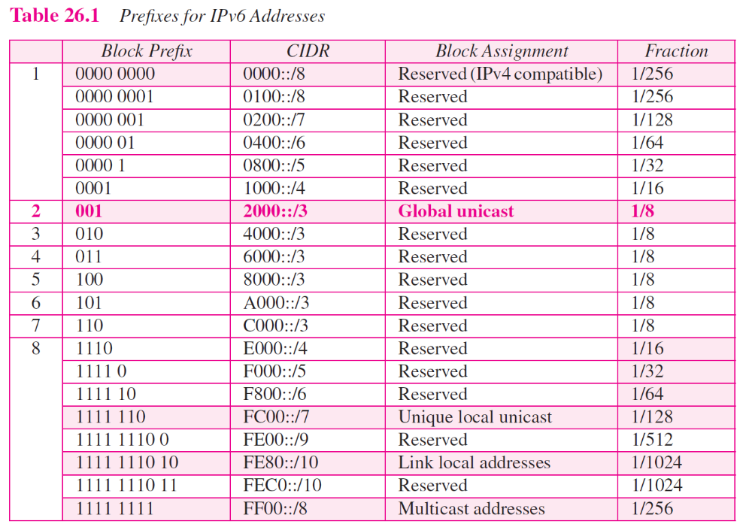

Slide 21
Example 26.8
Figure 26.5 shows that only a portion of the address space can be used for global unicast communication. How many addresses are in this block?
Solution
This block occupies only one-eighth of the address spaces. To find the number of addresses, we can divide the total address space by 8 or 2³ . The result is (2¹²⁸)/(2³) = 2¹²⁵ —a huge block.

Slide 22
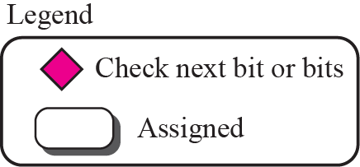

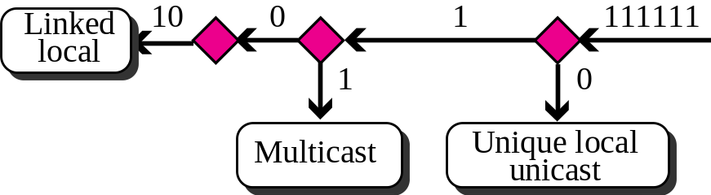
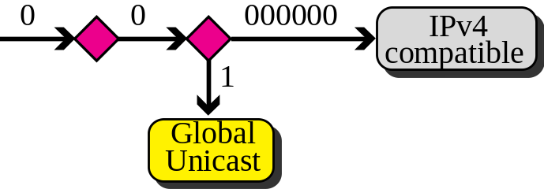
Figure 26.6 Algorithm for finding the allocated blocks

Slide 23
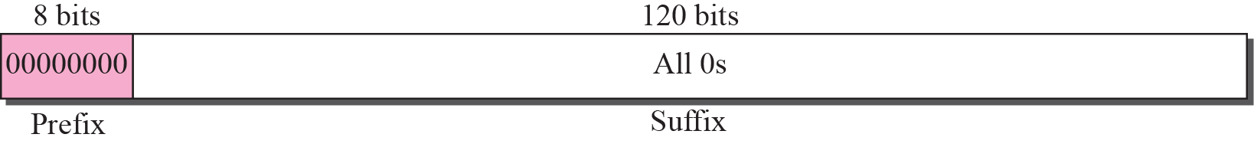
Figure 26.7 Unspecified address

Slide 24

Note
The unspecified address in IPv6 is ::/128. It should never be used as a destination address.

Slide 25
Example 26.9
Comparing the unspecified address in IPv4 to the unspecified addresses in IPv6.
Solution
In both architectures, an unspecified address is an all-zero address. In IPv4 this address is part of class A address; in IPv6 this address is part of the reserved block.

Slide 26
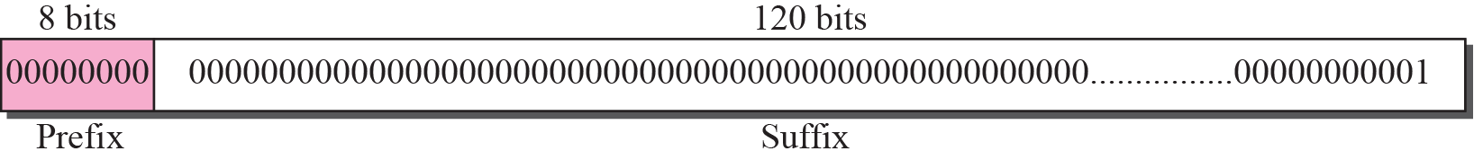
Figure 26.8 Loopback address

Slide 27
Note
The loopback address in IPv6 is ::1/128.
It should never be used as a
destination address.

Slide 28
Example 26.10
Compare the loop addresses in IPv4 to the loopback address in IPv6.
Solution
There are two differences in this case. In classful addressing, a whole block is allocated for loopback addresses; in IPv6 only one address is allocated as the loopback address. In addition, the loopback block in classful addressing is part of the class A block. In IPv6, it is only one single address in the reserved block.

Slide 29
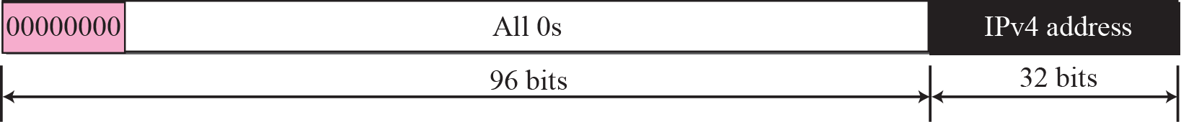
Figure 26.9 Compatible address

Slide 30
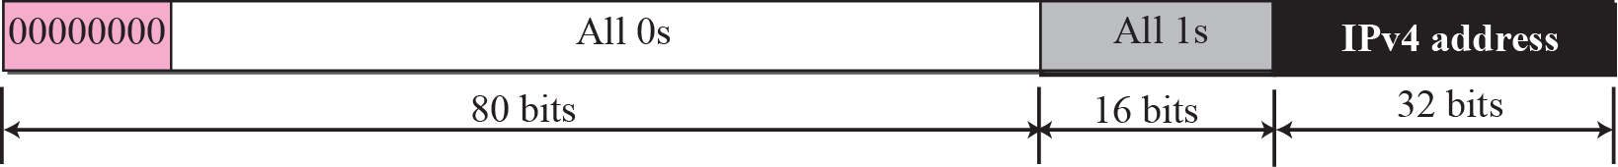
Figure 26.10 Mapped address

Slide 31
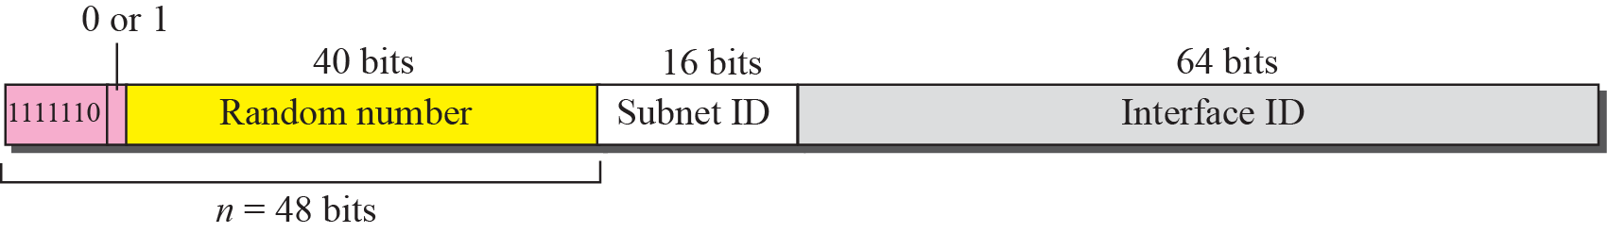
Figure 26.11 Unique local unicast address

Slide 32
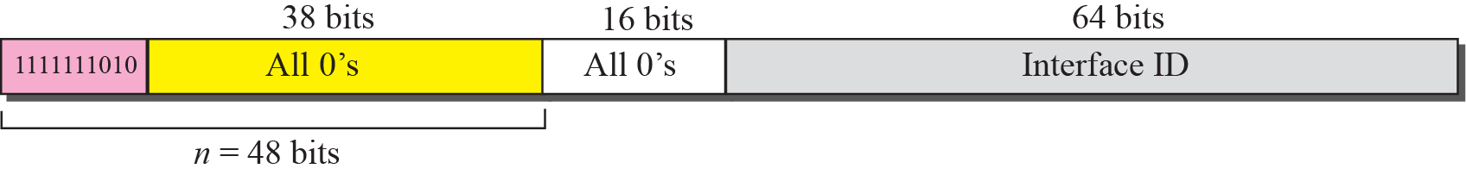
Figure 26.12 Link local address

Slide 33
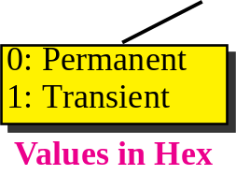
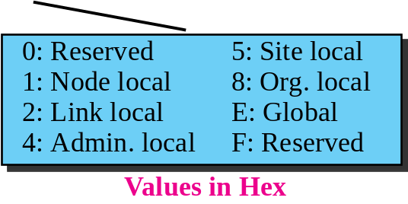
Figure 26.13 Multicast address

Slide 34
26-3 GLOBAL UNICAST ADDRESSES
This block in the address space that is used for unicast (one-to-one) communication between two hosts in the Internet is called global unicast address block. CIDR notation for the block is 2000::/3, which means that the three leftmost bits are the same for all addresses in this block (001). The size of this block is 2125 bits, which is more than enough for the Internet expansion in the many years to come.

Slide 35
Topics Discussed in the Section
Three Levels of Hierarchy

Slide 36
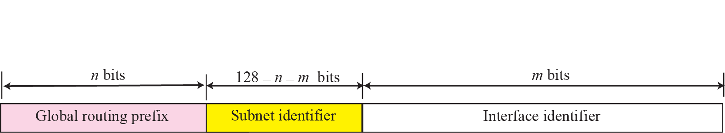
Figure 26.14 Global unicast address

Slide 37
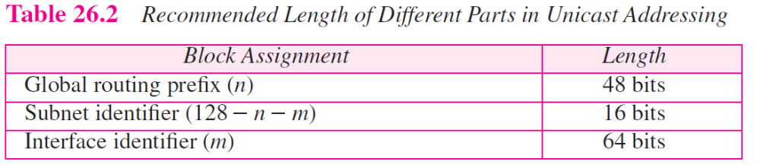

Slide 38
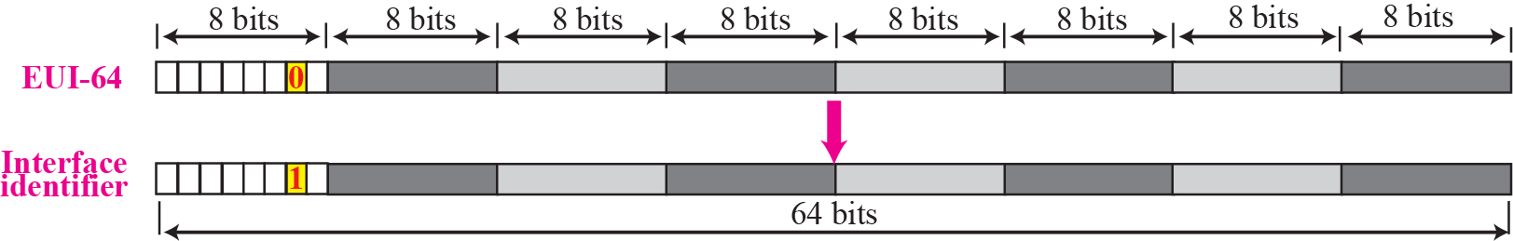
Figure 26.15 Mapping for EUI-64

Slide 39
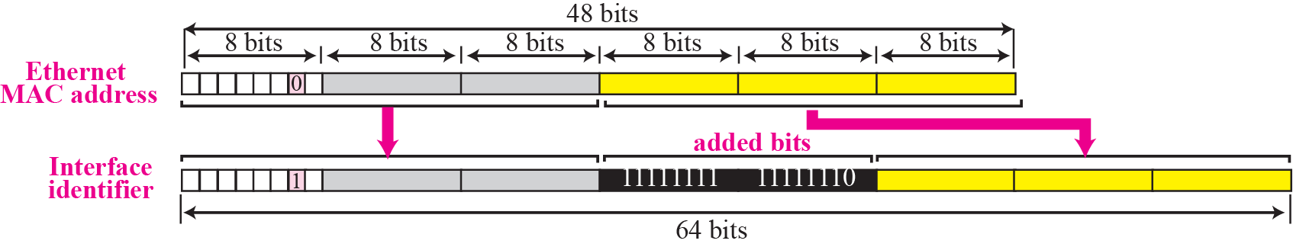
Figure 26.16 Mapping for Ethernet MAC

Slide 40
Example 26.11
Find the interface identifier if the physical address in the EUI is (F5-A9-23-EF-07-14-7A-D2)₁₆ using the format we defined for Ethernet addresses.
Solution
We only need to change the seventh bit of the first octet from 0 to 1 and change the format to colon hex notation. The result is F7A9:23EF:0714:7AD2.

Slide 41
Example 26.12
Find the interface identifier if the Ethernet physical address is (F5-A9-23-14-7A-D2)₁₆ using the format we defined for Ethernet addresses.
Solution
We only need to change the seventh bit of the first octet from 0 to 1, insert two octet FFFE16 and change the format to colon hex notation. The result is F7A9:23FF:FE14:7AD2 in colon hex.

Slide 42
Example 26.13
An organization is assigned the block 2000:1456:2474/48. What is the CIDR notation for the blocks in the first and second subnets in this organization.
Solution
Theoretically, the first and second subnets should use the block with subnet identifier 0001₁₆ and 0002₁₆. This means that the blocks are
2000:1456:2474:0000/64
and
2000:1456:2474:0001/64.

Slide 43
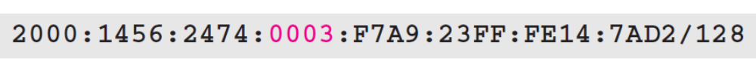
Example 26.14
An organization is assigned the block 2000:1456:2474/48. What is the IPv6 address of an interface in the third subnet if the IEEE physical address of the computer is (F5-A9-23-14-7A-D2)₁₆.
Solution
The interface identifier is F7A9:23FF:FE14:7AD2 (see Example 26.12). If we add this identifier to the global prefix and the subnet identifier, we get:

Slide 44
26-4 AUTOCONFIGURATION
One of the interesting features of IPv6 addressing is the autoconfiguration of hosts. As we discussed in IPv4, the host and routers are originally configured manually by the network manager. However, the Dynamic Host Configuration Protocol, DHCP, can be used to allocate an IPv4 address to a host that joins the network. In IPv6, DHCP protocol can still be used to allocate an IPv6 address to a host, but a host can also configure itself.

Slide 45
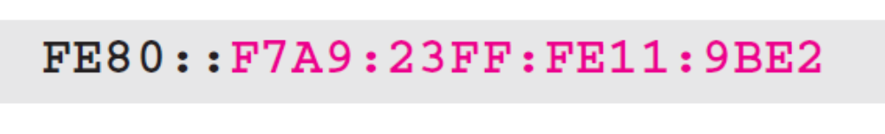
Example 26.15
Assume a host with Ethernet address (F5-A9-23-11-9B-E2)₁₆ has joined the network. What would be its global unicast address if the global unicast prefix of the organization is 3A21:1216:2165 and the subnet identifier is A245:1232.
Solution
The host first creates its interface identifier as
F7A9:23FF:FE11:9BE2
using the Ethernet address read from its card. The host then creates its link-local address as

Slide 46
Example 26.15 Continued
Assuming that this address is unique, the host sends a router solicitation message and receives the router advertisement message that announces the combination of global unicast prefix and the subnet identifier as 3A21:1216:2165:A245:1232. The host then appends its interface identifier to this prefix to find and store its global unicast address as:

Slide 47
26-5 RENUMBERING
To allow sites to change the service provider,
Renumbering of the address prefix (n) was built into IPv6 addressing. As we discussed before, each site is given a prefix by the service provider to which it is connected. If the site changes the provider, the address prefix needs to be changed. A router to which the site is connected can advertise a new prefix and let the site use the old prefix for a short time before disabling it. In other words, during the transition period, a site has two prefixes.

